Slide 1
STUDENT MANAGEMENT SYSTEM
Student Management System
Team - Ayush Shrivastava , Darshan Gupta , Vardhan Gupta.
GLA University , Mathura
Computer Science & Engineering
27-11-2023

Slide 2
INTRODUCTION
Imagine a school or college where everything about students, like their names, grades, attendance, and activities, is managed effortlessly with the help of a computer system. This is exactly what the Student Management System (SMS) project is all about!
The Student Management System is like a super-smart tool that helps schools and colleges keep track of all the important information about their students. It makes things much easier for teachers, staff, and even the students themselves.
Here's why the Student Management System project is so cool:
All-in-One Information Hub:
It's like a giant book that keeps all the important details about students, from their names to how well they're doing in their classes.
Quick and Easy Sign-Ups:
Enrolling in classes becomes a breeze. No more long lines or paperwork—just a few clicks and you're all set!
Keeping Tabs on Grades:
Ever wondered how you're doing in your classes? The SMS project helps you and your teachers keep track of grades, making it easy to see your progress.

Slide 3
OBJECTIVES
The project sets clear boundaries, including limitations on extensive customization beyond core functionality, pre-built integrations with specific third-party systems, and data migration from legacy systems in the initial phase.

Slide 4
PROBLEM STATEMENT
To create an interface for the suitability of Students connection with Staff for official educational purposes.
The Student Management System has a database of students data in an appropriate order , so it will not utter students and staff in any perspective related to the foundation of the portal which deals with all the issues regarding student’s information , results, activity records, etc. and for Head of Department(HOD) :- Adding Staff ,Students , Courses , etc.

Slide 5
LITERATURE REVIEW
The development and implementation plan of a Student Management System addresses
several gaps and challenges in traditional educational management . Here are some gaps
that the project aims to fill:
Manual Data Handling
Disorganized Academic Records

Slide 6
METHODOLOGY
The methodology for the Student Management System (SMS) project involves a systematic approach to ensure the successful development and implementation of the system
Front-End Technologies: For the user interface, HTML, CSS, and JavaScript are used. For web designing CSS Framework Bootstrap is used.
Back-End Technologies: For the back-end of the Student Management System which handles data processing and logic Python (Django) is used.

Slide 7
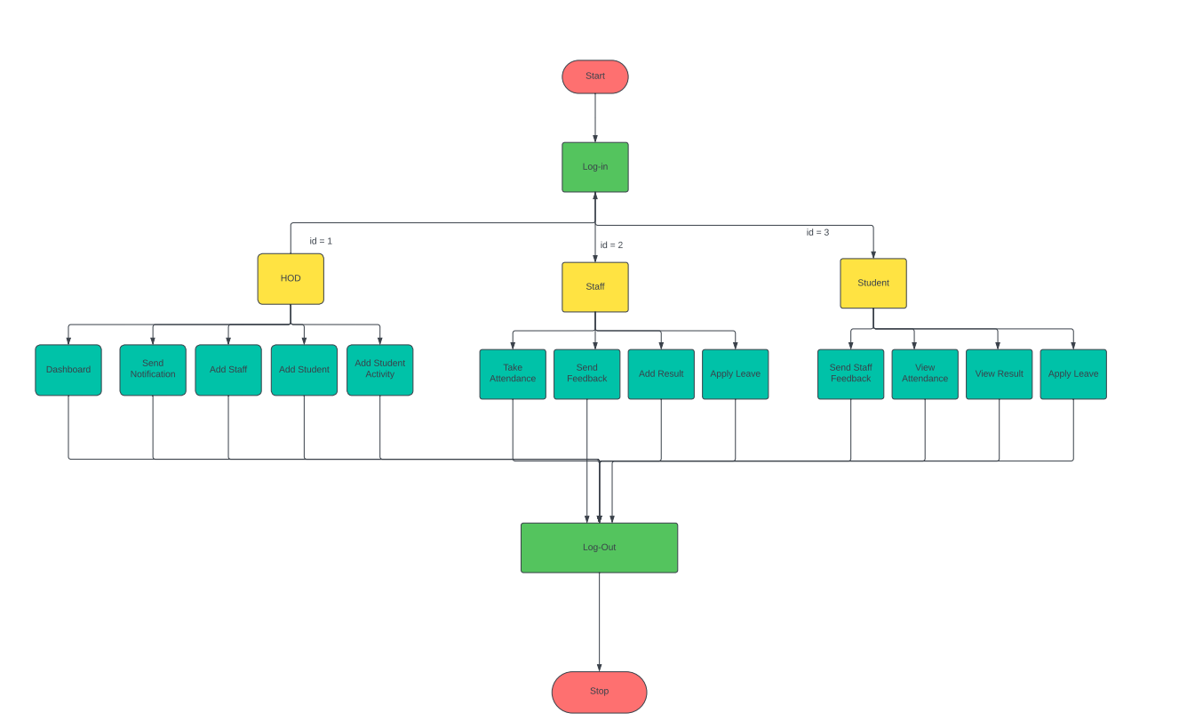
SYSTEM ARCHITECTURE

Slide 8
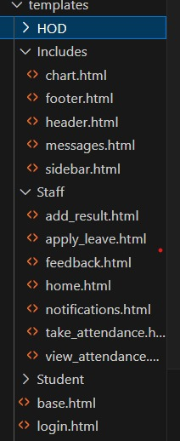
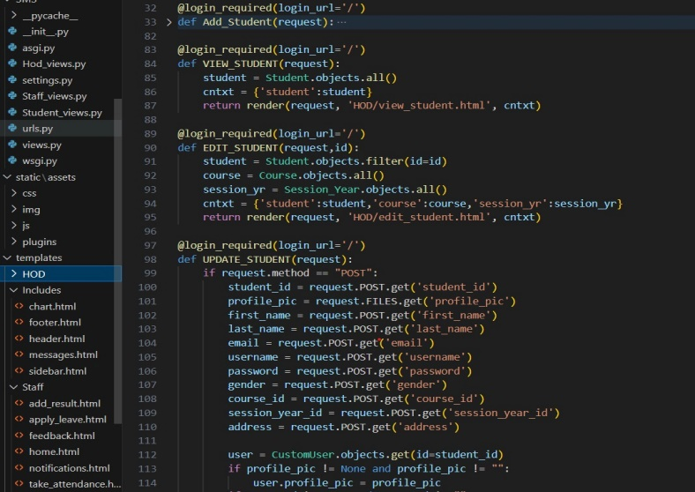
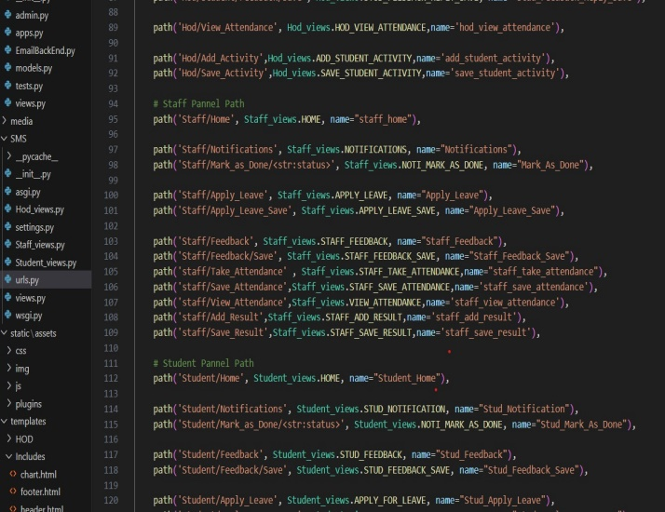
IMPLEMENTATION
Project Initiation and Requirements Gathering (Week 1)
System Design and Development (Week 2)
Testing and Quality Assurance (Week 3)
Deployment and Project Closure (Week 4)

Slide 9
FEATURES
Grade Management
Centralized Student Database
Secure Login Portals
Security of Student Data
Secure Access Portals
Student Activity Record

Slide 10
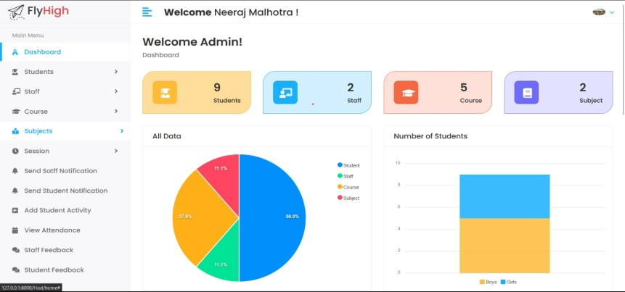
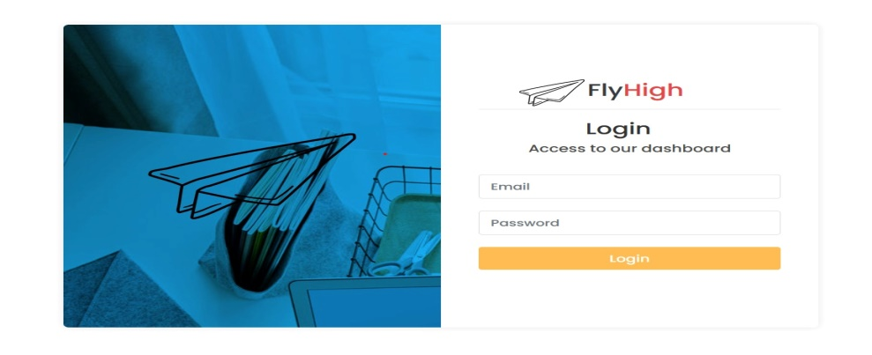
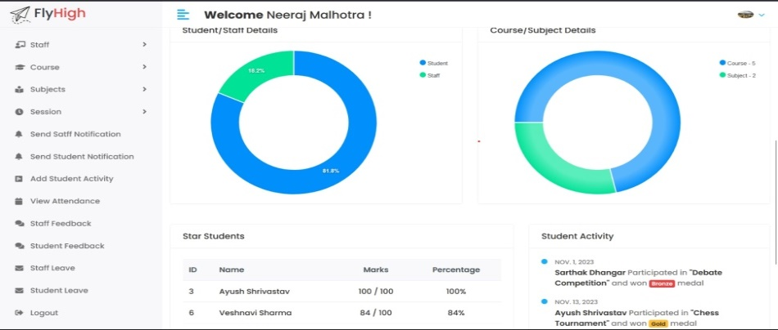
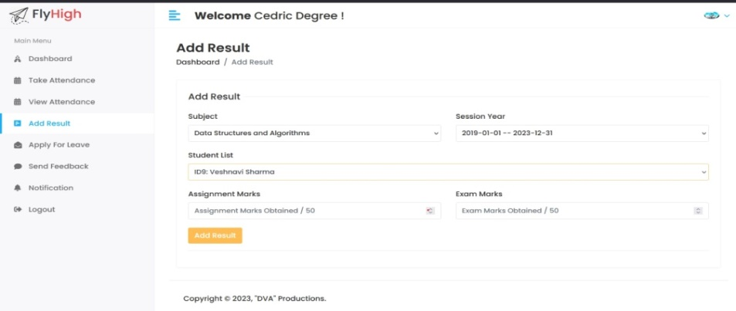
RESULTS

Slide 11
CHALLENGES FACED
Connectivity issues between different functionalities.
During development project can present various challenges, ranging from technical issues to organizational and user-related concerns.
Overcoming challenges during the development of project involves a combination of proactive planning, effective communication, and strategic problem-solving.

Slide 12
FUTURE WORK
Introduce new features based on user feedback or emerging educational trends.
Develop a mobile app for students, teachers, and parents to access the system on the go.
Implement a feedback system for students, teachers, and parents to provide input on the system's functionality and suggest improvements.
Enlargement of portal by introducing some different sections, like: Hostel Registration, Library Management , Transport Services , etc.

Slide 13
CONCLUSION
In summary, the Student Management System project is a crucial initiative for educational institutions. The key points of the presentation include:
Administrative Efficiency
Data Security and Privacy
Performance Monitoring
The Student Management System signifies some crucial points such as arranged data of students, attendance of students, courses ,results, feedback etc.

Slide 14
ACKNOWLEDGMENTS
We extend our heartfelt thanks to Mr. Suman Kumar Das for his guidance, support, and invaluable insights throughout the development process. His expertise and encouragement were instrumental in shaping the project and enhancing its quality.
This project stands as a collective achievement, and We are truly grateful for the collaborative efforts that have gone into its realization.

